Slide 1
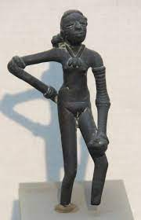
Indus Valley Girls
Deciphering the Indus Valley Script
Keerthana Jayakumar
Sonia Sharma

Slide 2
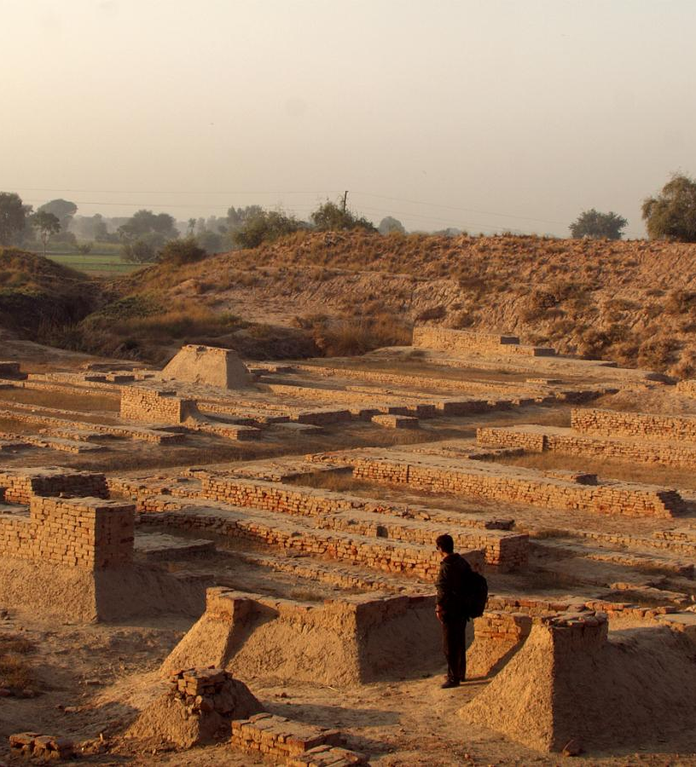
The Indus Valley/Harappan Civilization
Oldest civilization in the Indian subcontinent
Spanned from 5500 - 1300 BCE
Characterized by:
Highly evolved water management infrastructure and sanitation system
Standardized currency, weights and writing system
Lack of elaborate burials, places of worship and palaces
Interactions with the Mesopotamian empire
An undeciphered script

Slide 3
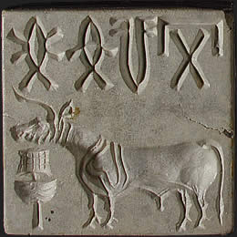
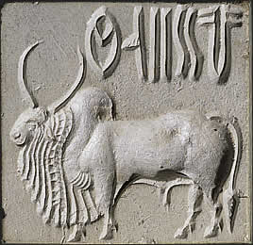
Why has Indus Valley Script not been Deciphered
Indus texts are very short. Mean length of Indus text length: 4.5 signs and longest text: 14 signs in a single line
This brevity also supports the theory that the Indus script is logosyllabic, meaning signs represented full words as well as syllabic sounds
Lack of context and usage information
Lack of bilingual inscription/tablet, e.g. Rosetta stone which recorded two Egyptian scripts and ancient Greek
Debate over identity of Indus language – E.g. Dravidian (southern India)
Decline in Indus Valley cultural traditions
Notes:
https://www.harappa.com/answers/why-has-language-harappa-not-been-deciphered
https://www.discovermagazine.com/planet-earth/why-we-still-cant-read-the-writing-of-the-ancient-indus-civilization

Slide 4
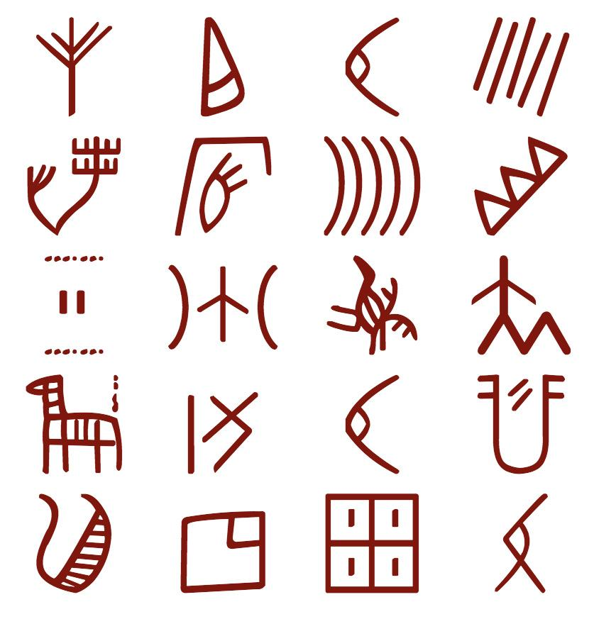
Current Research
Since 2013, there have been breakthroughs in the field of population genetics that have given clues about the root language of the script.
2013 paper ‘South Asia: Dravidian Linguistic History’ authored by Professor Franklin C. Southworth and Dr David W. McAlpin reconstructed Proto Dravidian (one of two main Indian language families) vocabulary and found similarities with Proto Elamite vocabulary ( language of the Zagros region).
Through their archeological and linguistic research, they concluded:
Harappan language is most likely Proto Dravidian (with influences from Proto Elamite)
This language has evolved into the major modern Dravidian languages (Tamil, Telugu, Kannada, etc).
We are testing the hypothesis that Proto Dravidian is the language of the Harappans by comparing modern Tamil with Harappan script
Notes:
https://www.harappa.com/answers/why-has-language-harappa-not-been-deciphered

Slide 5
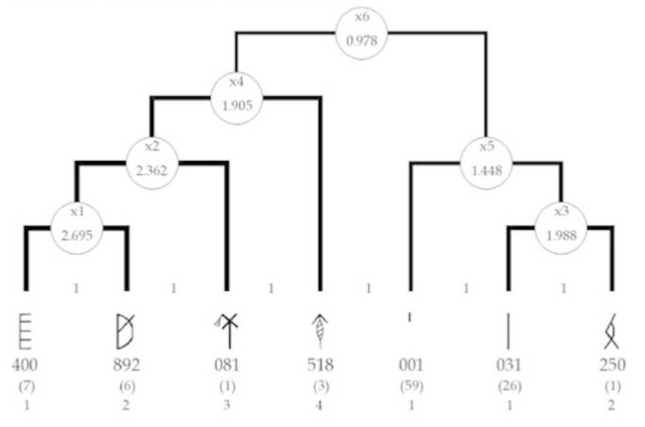
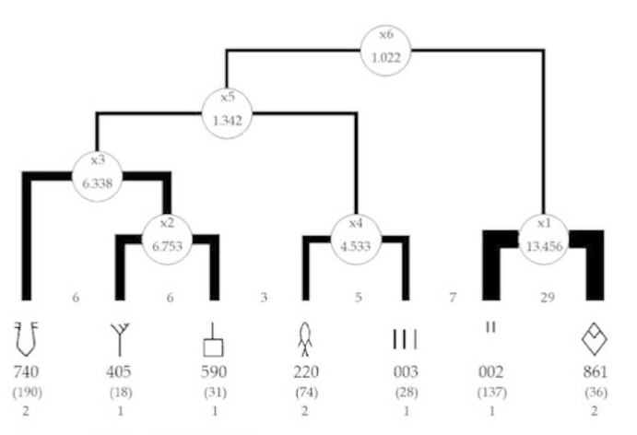
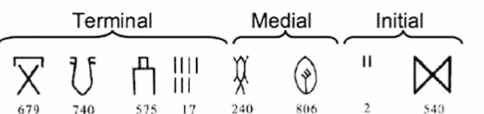
Patterns of Sign Use
*Height of segmentation tree inversely correlated with degree of organization of text
The script is read from right to left.
Can be divided into two types
Complex
No predictable syntax
Possibility of syllabic spellings in a second language
Patterned
Follows predictable syntax (initial, medial and terminal)
Fixed inventory of signs in each field
Complex Text
Patterned Text

Slide 6
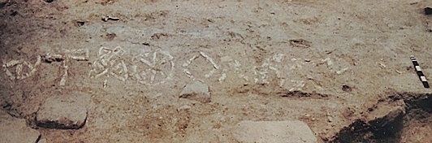
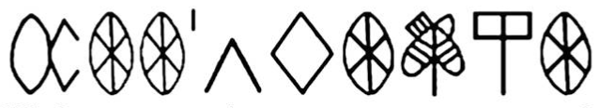
Proof of SOV/OSV
A place name has been identified in the Dholavira Signboard artifact:
It appears in either the initial or medial position in other texts.
Demonstrates that the Indus script is a Subject-Object-Verb or Object-Subject-Verb construction just like Proto-Dravidian.
The Dholavira Signboard

Slide 7
Purpose
To partially decipher ancient Indus Valley (Harappan) script by comparing it to modern Tamil (Dravidian language)
Indus Valley script is logosyllabic (characters represent syllables)
Our strategy:
Convert Tamil script from syllabic to logosyllabic by converting morphemes to separate signs
Perform statistical analysis to compare converted script with Indus script

Slide 8
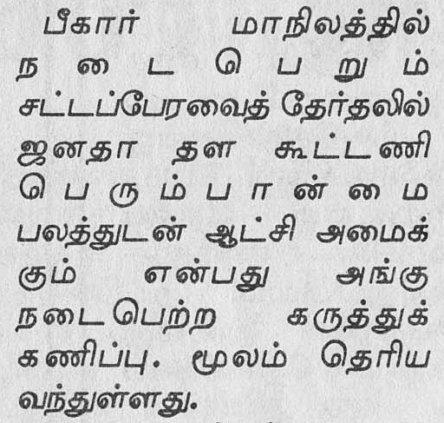

Data Preprocessing - Introduction to Tamil
Tamil is a language with Agglutinative Morphology - It consists of a root to which various affixes are attached.
All of these components are morphemes
Converted Tamil morphemes to signs (ex 001) to compare it with the Indus script
Logosyllabic Conversion
Logographic Conversion
001-002 -003-004 -005 -006 - 007 -008 -009 -010
001 -003 -005 -006 - 007 -008 -009 -010

Slide 9
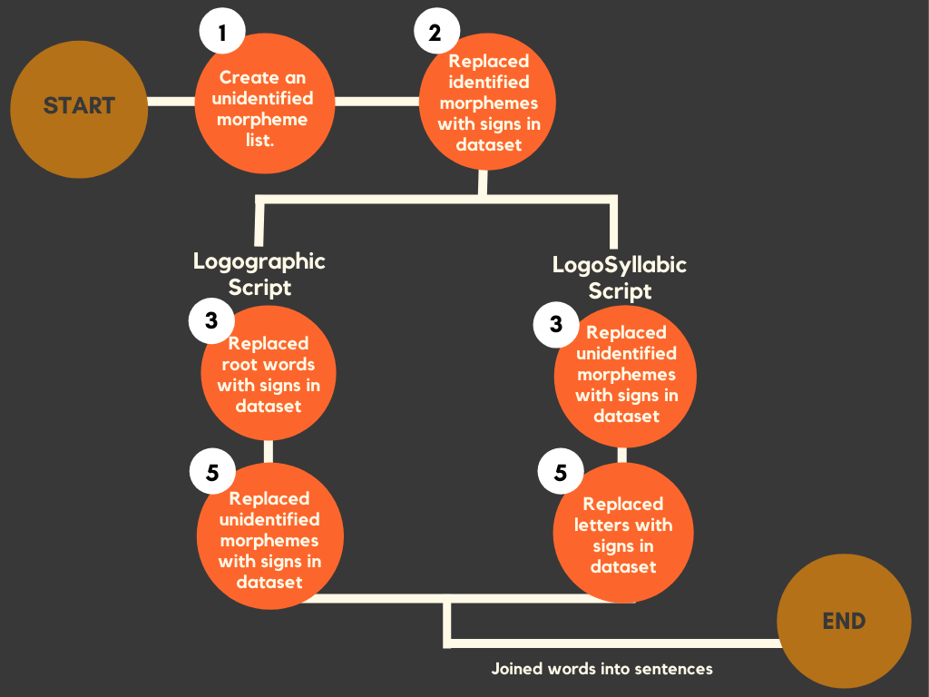
Data Preprocessing - Steps
Data Source
Tagged POS Tamil database
Tools
Pandas for preprocessing
PostgreSQL instance on Amazon AWS for database storage
The database had already separated some morphemes.

Slide 10
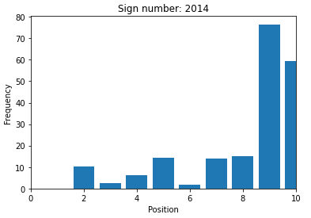
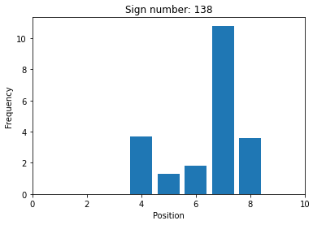
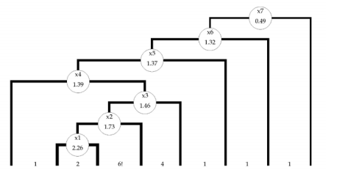
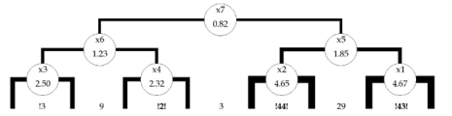
Analysis
Using Positional Histograms on the converted Tamil dataset to find possible Initial, Medial and Terminal signs.
Calculating connectivity between sign groups using multivariate segmentation analysis and comparing it to Indus sign groups.
Goal: Identify morphemes with similar distributions in both scripts.
Progress: Histograms created, connectivities calculated.
Comparison pending.

Slide 11

Machine Learning
Created a SVM algorithm to automatically perform morpheme extraction on modern Tamil
Preprocessed data and selected features: index, vowel/consonant, noun, verb, current letter encoded, current prefix encoded. Output label for our model was morpheme boundary.
75% training and 25% testing data split, rbf kernel with a gamma of 0.8 to achieve an accuracy of 76%.

Slide 12
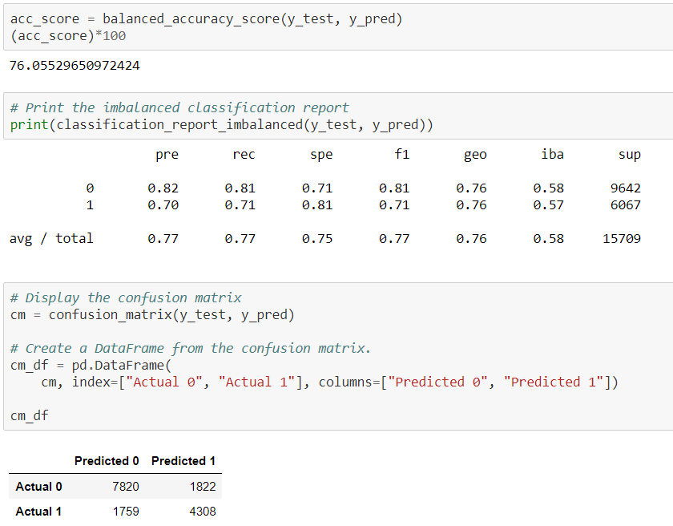
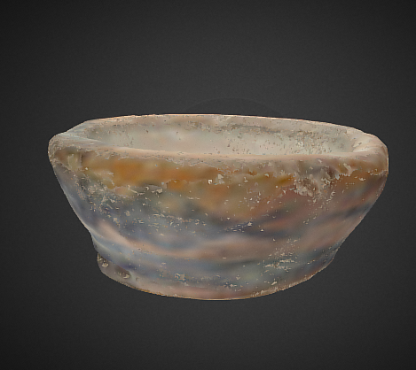
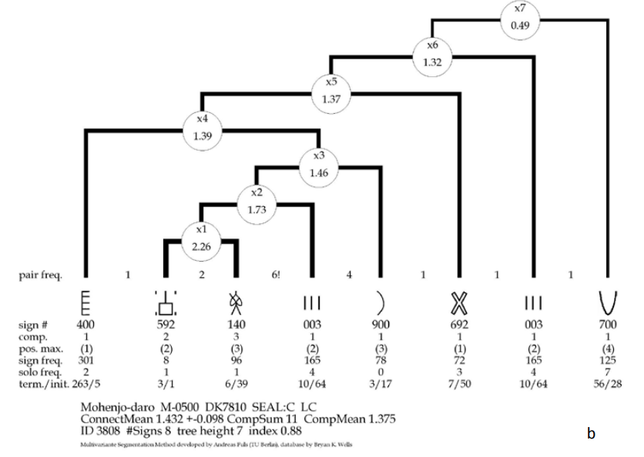
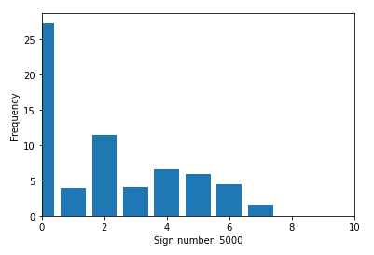
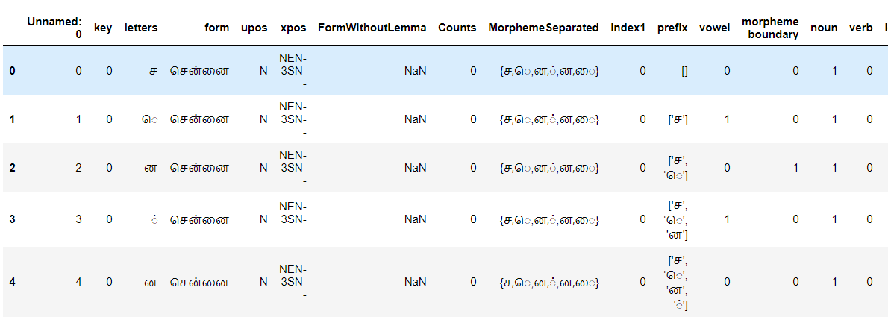
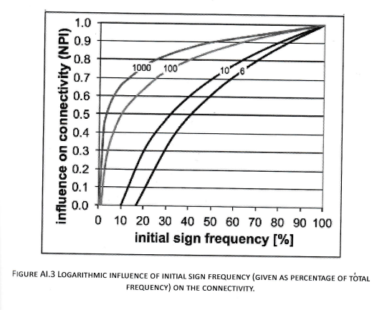
Visualization
Shows:
SQL dataframes containing segmented morphemes and corresponding signs
Machine Learning SVM accuracy results
Statistical Analysis of Tamil and Indus scripts (frequency histograms, decision trees)
Users will be able to click on each section to view SVM results, dataframes, statistical analysis results
Plan to host webpage on Heroku

Slide 13
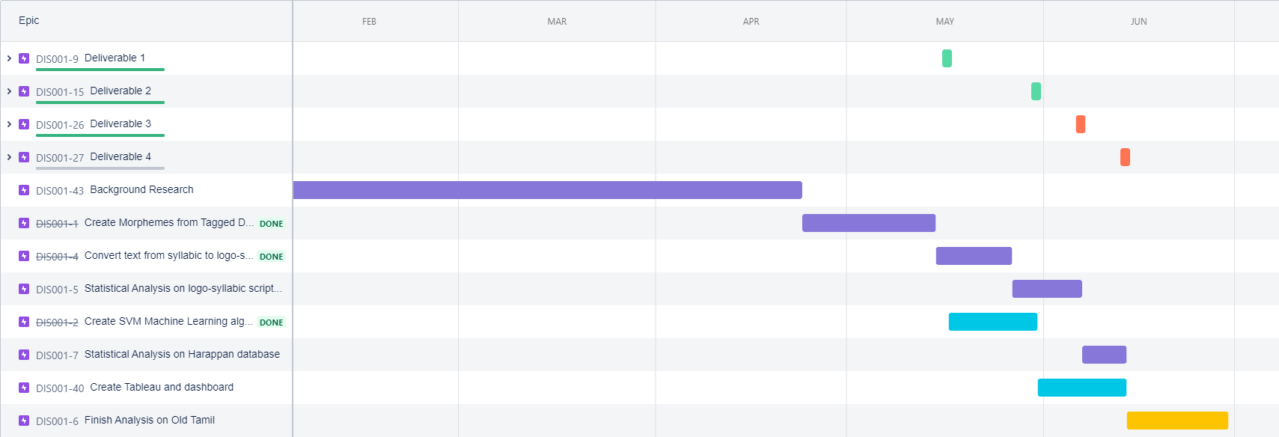
Activity Roadmap

Slide 14
Next Steps
Complete Comparison of two scripts.
Use SVM machine learning algorithm to convert Simpler SOV/OSV Sentences to LogoSyllabic and run analysis.
Convert Old (Sangam Tamil, Tamil Brahmi Script) to LogoSyllabic and run analysis.
Create feature in Visualization to:
Run the SVM algorithm on a Tamil csv file/text to segment morphemes
Automatically convert the segmented script to logosyllabic
Automatically run analysis and show results

